Slide 1


Leaders: Introduction and Use of the System
Denise Ricks

Slide 2
Agenda
1
What is Navvy+?
2
Navvy+ Formative Essentials
3
Navvy+ Seasonal Screening Essentials
4
Reflect & Close

Slide 3

Learning objectives
Understand the functional purpose for Navvy+ in a school-wide data-based decision making model
Navigate the Navvy+ platform to identify resources and understand key workflows
Identify key planning considerations for effective implementation

Slide 4



Considerations
Please feel free to ask questions in the Q&A. The chat will be used for links and resources provided by Pearson.
This slide deck is copyrighted and can only be used for distribution with individuals associated with the DoWEA + Pearson contract.
This session will be recorded and available for the school year.

Slide 5

What is Navvy+?

Slide 6
Balanced assessment system
What is navvy+
Standards-level Formatives
Summative
Fall Screening
Winter Screening
Spring Screening
Standards-level Formatives
Standards-level Formatives
Progress Monitoring

Slide 7

Navvy+’s
Theory of Action
What is navvy+
Plan
Teach
Make a plan to address student needs using Navvy’s instructional resources
Provide best first instruction and learning opportunities for students
If it isn’t timely, we can’t use it
If it isn’t accurate, it could misguide our next steps
If it isn’t specific, we can’t act on it
Reflect on Results
Check Understanding
Use Roster by Standard, Component Accuracy, and Practice Response Frequency reports to review data and identify student level of support
Assign standards-level Competency Checks and Practice Checks to measure understanding

Slide 8

Navvy+ Formative Essentials

Slide 9

Navvy+ Formative Assessment Design

Slide 10
Navvy+ Assessment Blueprints: Proprietary and Rigorous
Navvy+ assessment design

Slide 11
Depth of Knowledge (DOK)
Navvy+ assessment design
Level | DOK Characteristics
DOK 1 | Recollection, recall or identification of a fact, term, principle or concept. It’s a “just right there” answer most often.
DOK 2 | Involves skills and concepts that require students to engage in some mental processing beyond recall, such as applying concepts, making decisions, or organizing information.
DOK 3 | Necessitates reasoning or strategic thinking to answer complex questions, often involving abstract thinking and background knowledge.​

Slide 12
Item breakdown
Navvy+ assessment design
 | DOK 1 | DOK 2 | DOK 3
Component 1
Component 2
Component 3
= item

Slide 13
Standard Description & Navvy+ Blueprint
Navvy+ assessment design

Slide 14
Navigation Pane and Standards Directory
Navvy+ assessment design

Slide 15
Navvy+ assessment design
Platform
demo
Platform overview & Standards

Slide 16
Treasure Hunt: Formative
Navvy+ assessment design
Log in
Find
Identify
Locate
Log in to a training account
Standard and Components
Grade 5 Math: Fractions
Hint: Standards Directory
Standard 6.EE.1 Facilitated Activity
Hint: Learning Library
Navvy Overview Video
Hint: Support Hub
5:00

Slide 17
Navvy+ Formative
Check understanding

Slide 18

Navvy+ Checks
Check understanding
Competency Checks
Practice Checks
Diagnose standard-level competency
Up to 3 opportunities to show competency
Pre-built; 6-8 items
Secure, valid, & reliable
On-grade-level standards, one standard at a time
ELA and Math Grades K+
Option to build your own Checks to provide flexible, targeted learning support, or use a Blueprint Practice Check that is prebuilt
Unlimited retakes and review
Non-secure questions
On- or off-grade-level standards; one or many standards at a time
ELA and Math Grades K+

Slide 19
Assigning Competency and Practice Checks
Check understanding
Standards
  Standard Set (Subject and Grade)
  Standard Category
  Domain
  Standard
Students
  Select one or multiple classes
Availability
  Select assessment availability
  Assessment window up to 72 hours

Slide 20

Managing Check Assignments
Check understanding
Management options
  Manage window
  See who assigned the Check
  See, edit, or end the Check’s availability
  View report data for the Check
Home page
  Most recent assignments only
Assignments page
  All assignments: past, current, future

Slide 21
SmartSets
Personalized practice for every stage of learning
Check understanding
Explore
Extend learning by focusing on a standard not yet attempted for competency
Develop
Build understanding of an attempted standard where competency hasn’t been reached yet
Strengthen
Reinforce understanding of a standard where competency has been achieved

Slide 22
Check understanding
Platform
demo
Competency Checks, Practice Checks, & SmartSets

Slide 23

Use cases for Checks and SmartSets
Check understanding
Competency Checks
Practice Checks
SmartSets
Determine whether the student is competent at the standard
After a pre-test (Practice Check)
After reteaching
Provide targeted support after a Competency Check
Pre-test
Spiral review
Homework
In-class designated time (e.g., Fun Friday)
After data review
Extra review at home
Bellringers or exit tickets
Personalized independent work
Student-initiated additional practice

Slide 24

Navvy+ Formative
Results & Reports

Slide 25
Accessing reports
Navvy+ formative: Results & reports

Slide 26
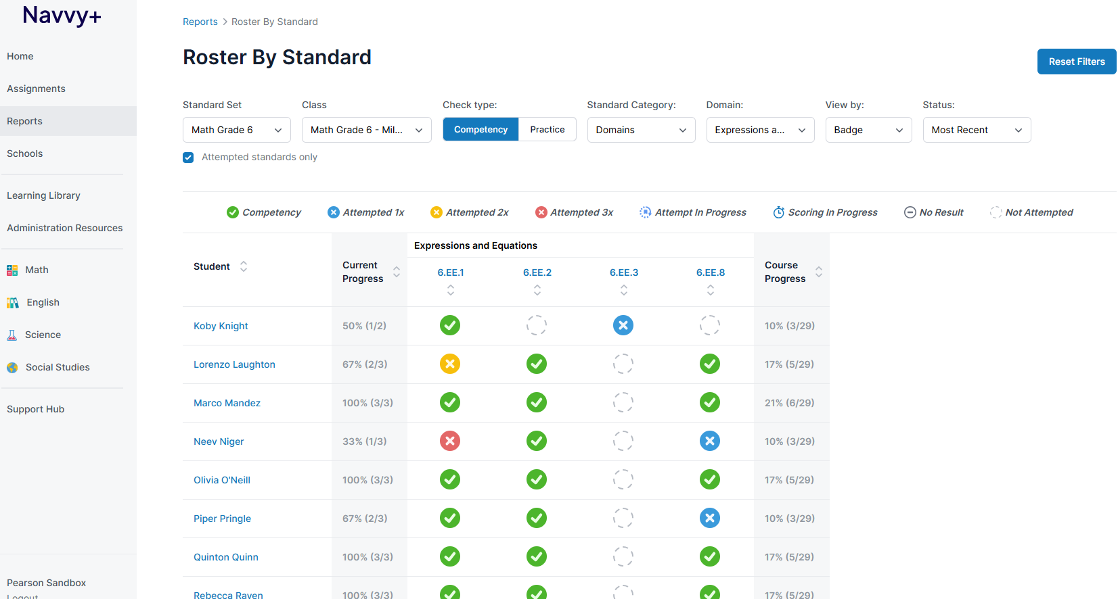
Roster by Standard
Navvy+ formative: Results & reports

Slide 27
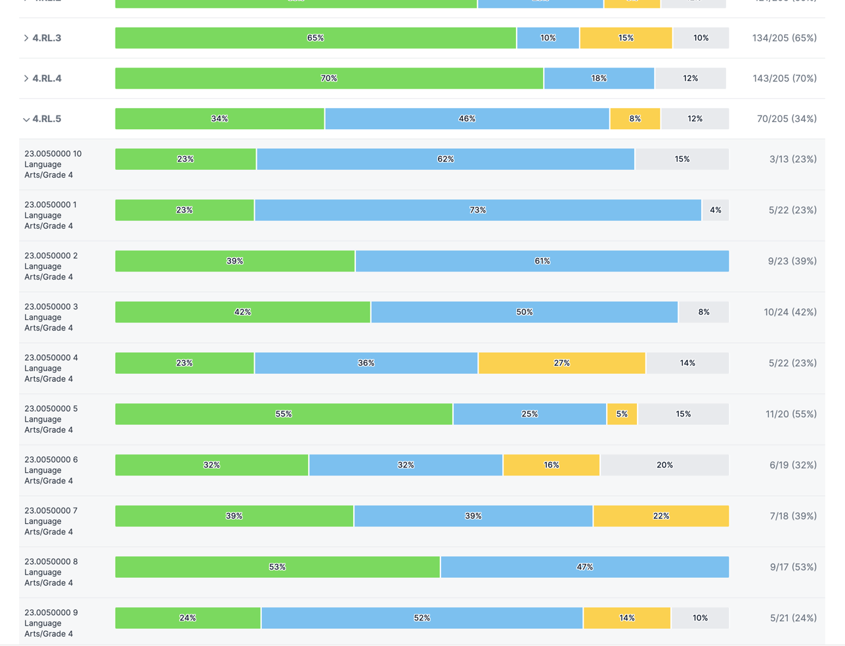
School Standards Performance
Use the data to guide instructional next steps by identifying patterns at the school level
Consider from the data: What instructional supports or PL can we provide for teachers on challenging standards?
Navvy+ formative: Results & reports

Slide 28
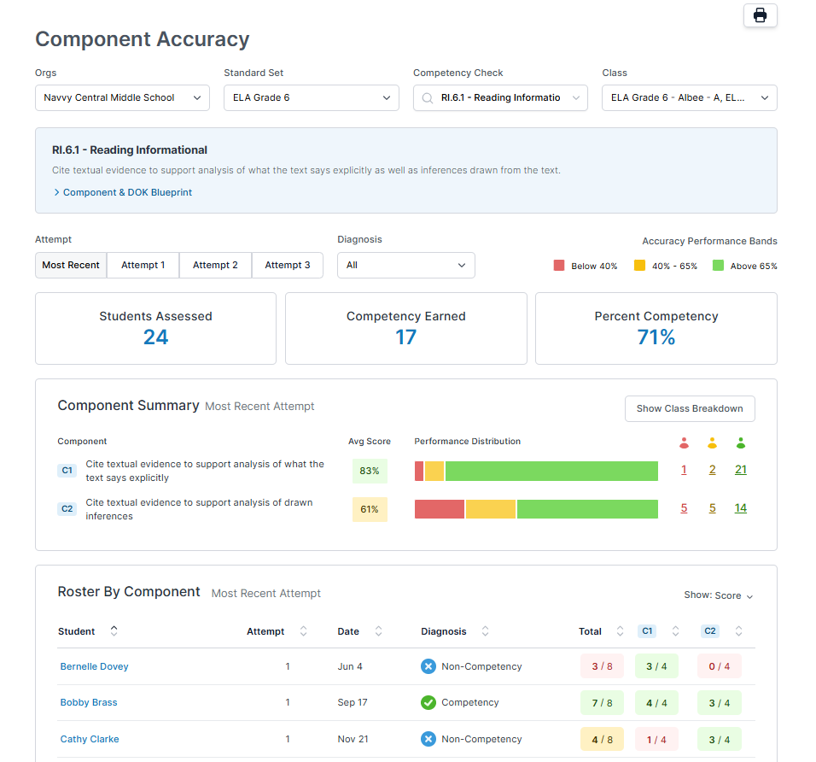
Component Accuracy
Gives a breakdown of the standard components from the Competency Checks
Consider from the data: How does student learning compare in each component of the standard?
Navvy+ formative: Results & reports

Slide 29
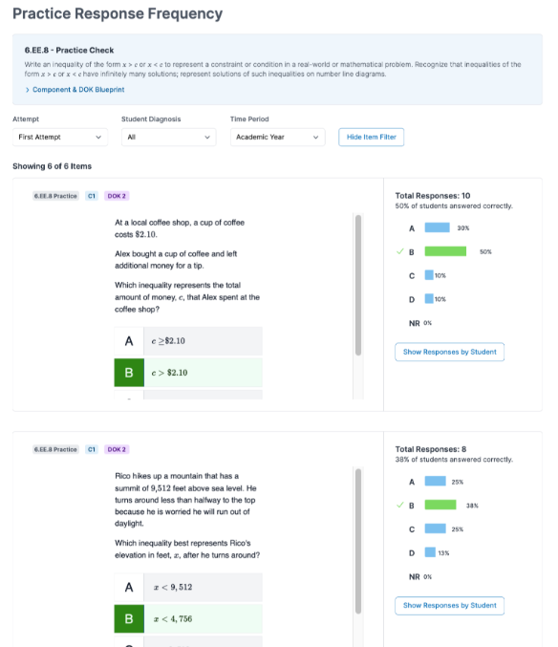
Practice Response Frequency
Gives a breakdown of Practice Check item responses
Consider from the data: What are the common mistakes, misunderstandings, or misconceptions?
Navvy+ formative: Results & reports

Slide 30
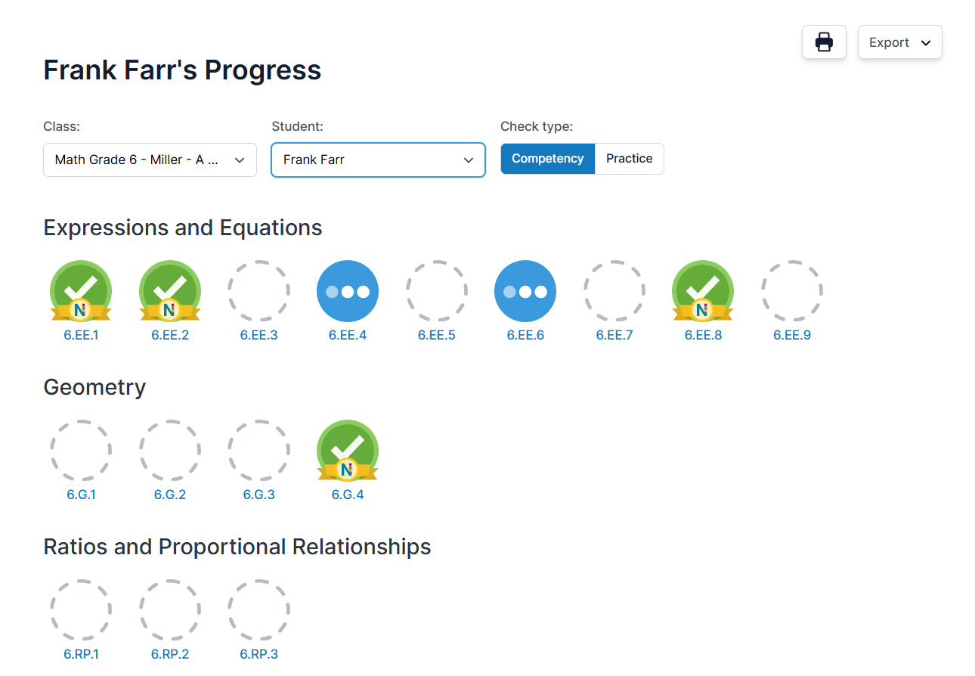
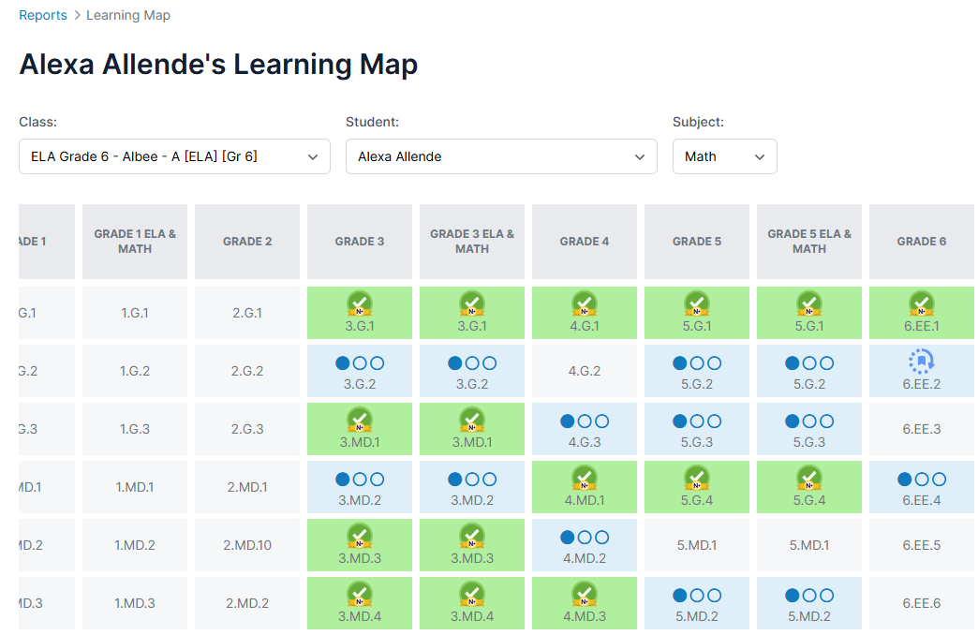
Student facing reports
Navvy+ formative: Results & reports
Student Progress
Learning Map

Slide 31
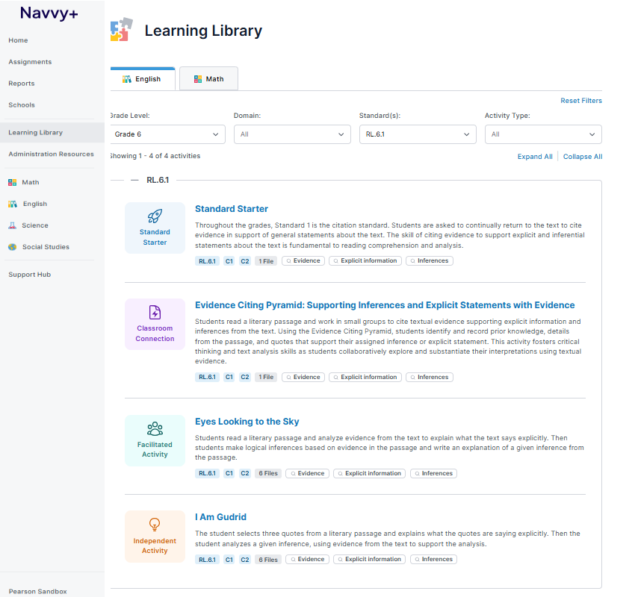
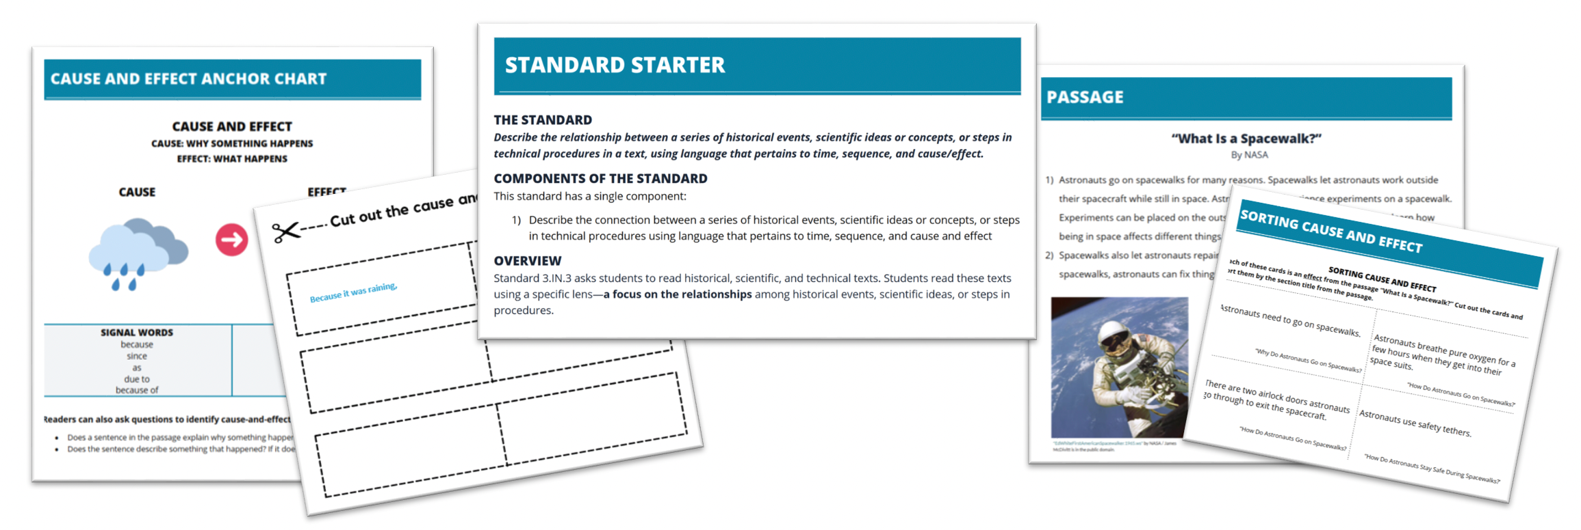
Instructional resources: Learning Library
Navvy+ formative: Results & reports
Answer the question "What's next?"
Deliver quality instructional supports aligned to each standard
Copyright 2026 Pearson. All rights reserved. Materials for use by DoWEA during the 2026-2027 school year.

Slide 32

Navvy+ Formative
Student Experience

Slide 33
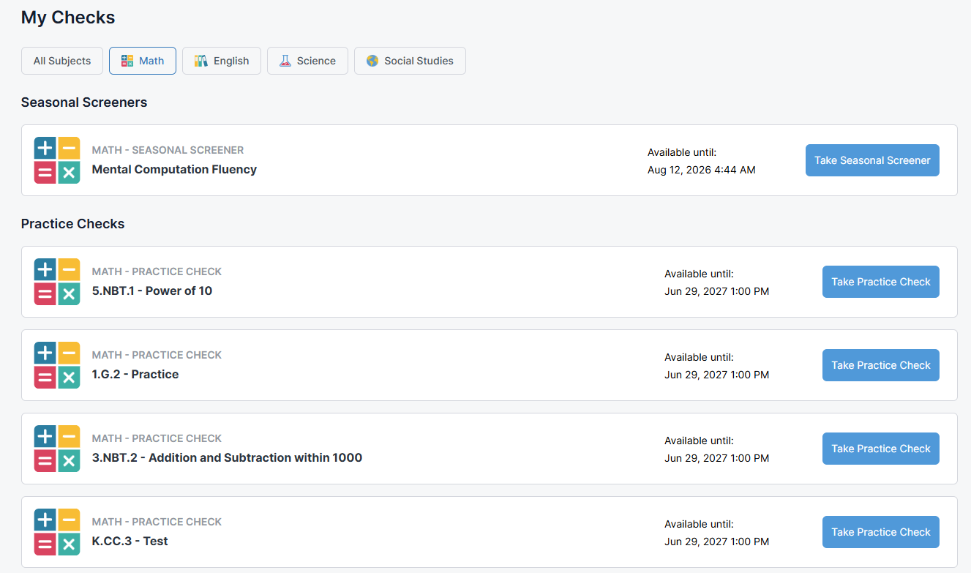
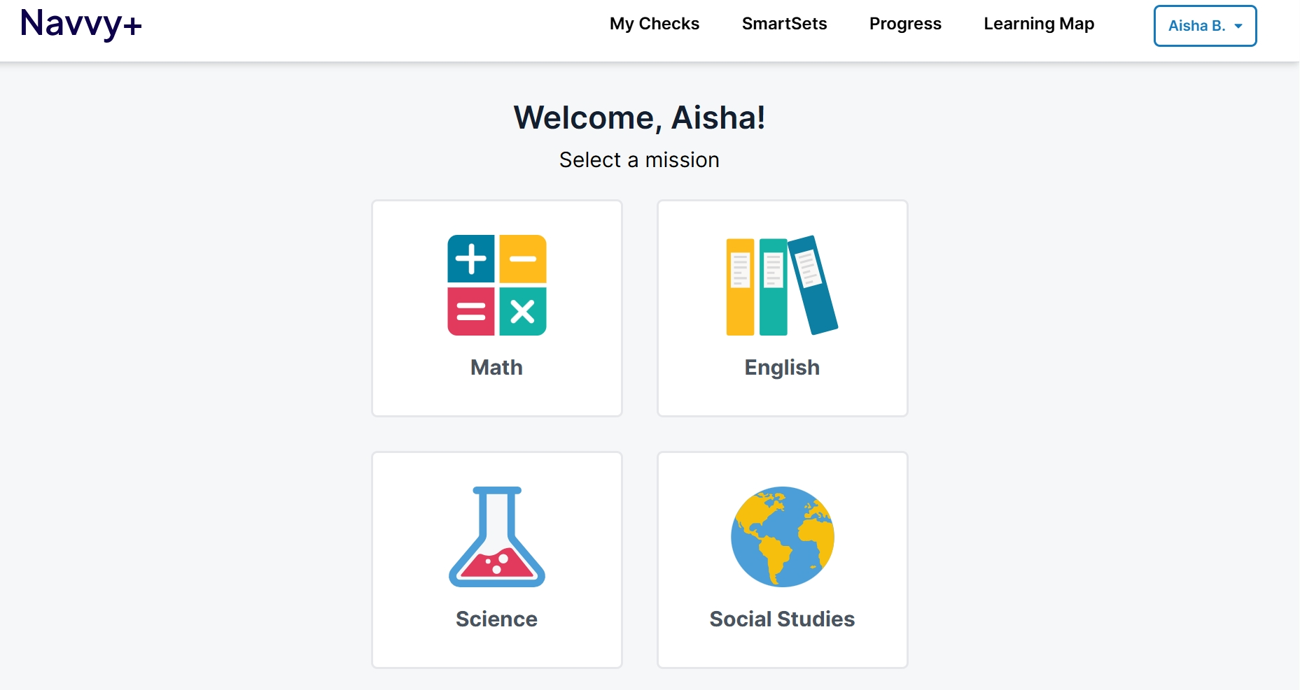
Student experience
Navvy+ formative: student experience
Login using Classlink and find the Pearson Launchpad app
Select subject
Separated by Seasonal Screeners and Checks

Slide 34
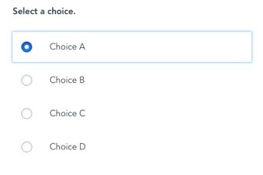
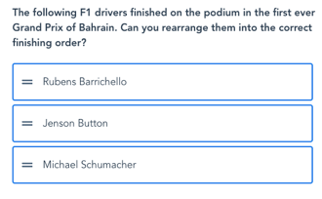
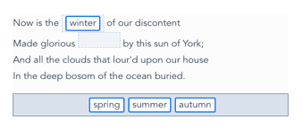
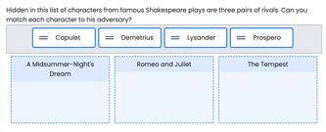
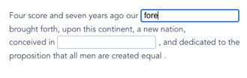
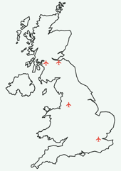
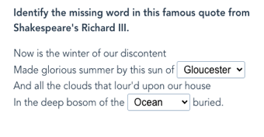
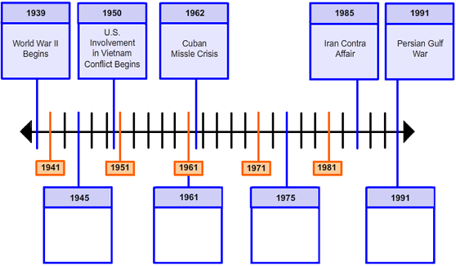
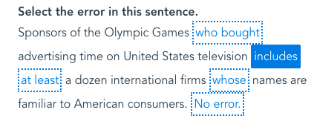
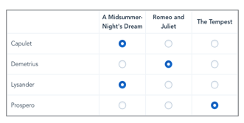
Item types
Navvy+ formative: Student experience
Multiple Choice/ Multiple Select | Text Entry | Gap Match | Basic Match | Ordered Lists
Inline Choice | Hot Spot | Graphic Gap Match | Hot Text | Tabular Match

Slide 35
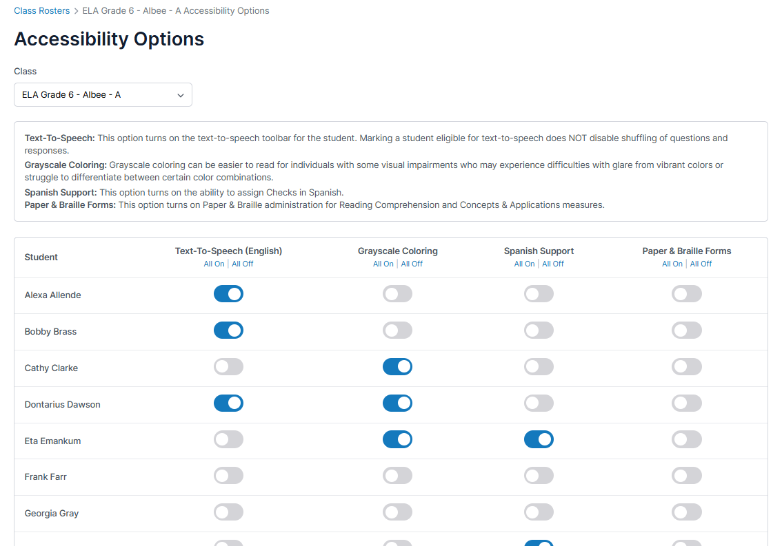
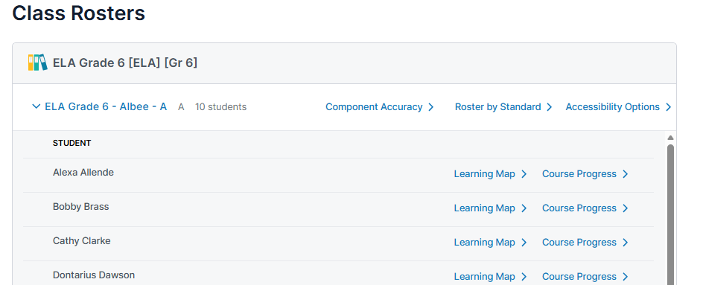
Accessibility options: By roster
Navvy+ formative: Student experience

Slide 36
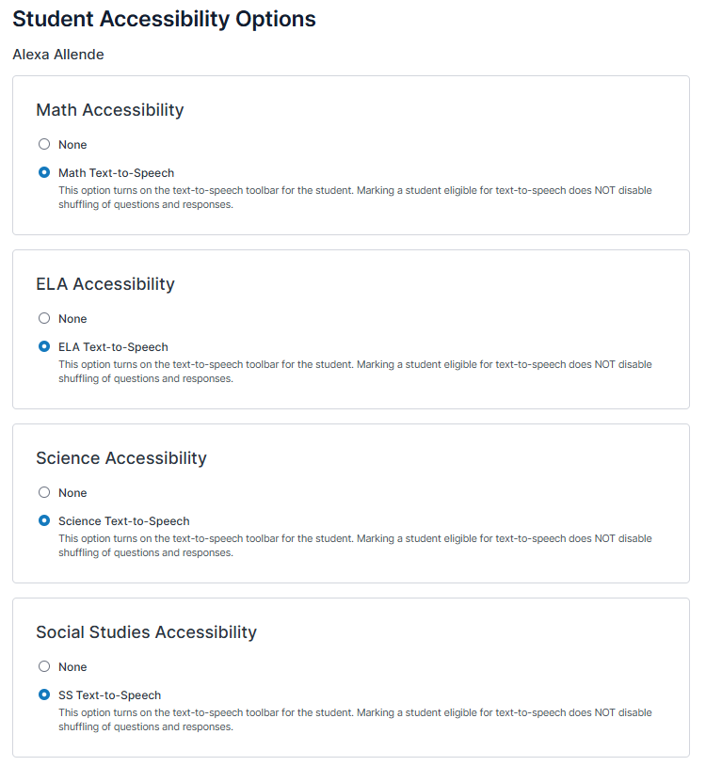
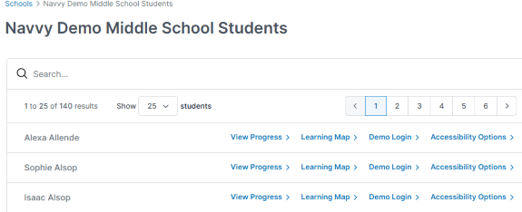
Accessibility options: By student
Navvy+ formative: Student experience

Slide 37
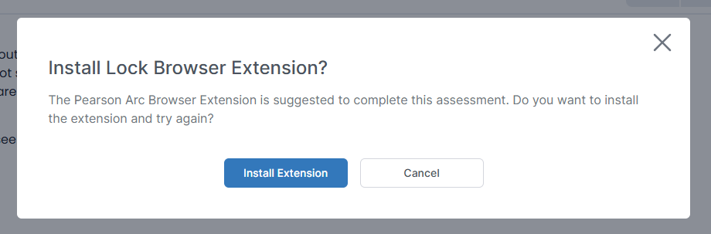
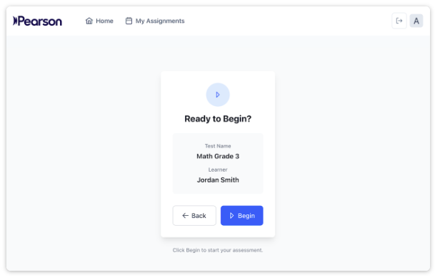
Lock Browser Extension: Online delivery
Navvy+ formative: Student experience
Secure and privacy-first browser extension
Restricts access to other browser tabs, windows, external applications
Runs in full-screen mode to reduce distractions
Monitors session activity and provides real-time alerts to local school proctors
Enables secure, uninterrupted online test interactions

Slide 38
Platform demo
Navvy+ formative: Student experience
Platform
demo
Student experience

Slide 39
Student experience: Orientation Check
Navvy+ formative: Student experience
Home page
Find
Choose
Open
Login and scroll to the bottom of the home page
Click where it says Navvy Orientation Check
Browse and pick an Orientation Check to take
Open the Administration and Scoring Guide and browse
5:00

Slide 40

Navvy+ Seasonal Screening Essentials

Slide 41

Seasonal Screening
Overview

Slide 42
Balanced assessment system
Seasonal Screening overview
Standards-level Formatives
Summative
Fall Screening
Winter Screening
Spring Screening
Standards-level Formatives
Standards-level Formatives
Progress Monitoring

Slide 43

A connection to something well known
Seasonal screening overview
Screening provides information on foundational skills that help educators identify additional instructional support or enrichment.

Slide 44





Know your data cycle
Seasonal screening overview
Screen
Identify
Plan
Monitor
Adjust
Copyright 2026 Pearson. All rights reserved. Materials for use by DoWEA during the 2026-2027 school year.

Slide 45
Seasonal screening windows
seasonal screening overview
Beginning of Year
9/15-10/30
End of Year
5/2-last day of school
Fall
Winter
Spring
Middle of Year
12/1-1/29
Best practice: Test within a two-week period within each window
Copyright 2026 Pearson. All rights reserved. Materials for use by DoWEA during the 2026-2027 school year.

Slide 46



Administration methods
Seasonal screening overview
Facilitated delivery
Individually administered
Requires printed stimuli for students
Teacher easily marks student responses on computer
Built-in timer and directions
Auto-scored
Online delivery
Group or individually administered
Standardized directions are found in the Administration Resources
Headphones required for group administration
Students launch directly from their My Checks dashboard in Navvy+
Paper/pencil delivery
Group or individually administered
Provide printed test materials to students
Read scripted directions to the students
Utilize external timer and directions
Educator logs responses as correct or incorrect in Navvy+ to generate a score

Slide 47






Foundational reading skills
Seasonal screening overview
Phonemic awareness
Phoneme Segmentation
Initial Sounds
Phonics
Nonsense Word Fluency
Letter Word Sounds Fluency
Letter Naming Fluency
Word level reading fluency
Word Reading Fuency
Nonsense Word Fluency
Sentence level reading fluency
Silent Reading Fluency
Oral Reading Fluency
Vocabulary
Auditory Vocabulary
Vocabulary
Comprehension
Reading Comprehension
Copyright 2026 Pearson. All rights reserved. Materials for use by DoWEA during the 2026-2027 school year.

Slide 48





Essential math sequence
Seasonal screening overview
Number Naming -> Cardinality
Number Naming Fluency
Quantity Total Fluency
Comparing
Quantity Difference Fluency
Number Comparison Fluency- Pairs
Addition & Subtraction
Math Facts Fluency-Tens
Math Facts Fluency- 1 Digit
Number Sense (Gr 2-8)
Number Sense Fluency
  Number Comparison Fluency Triads
  Mental Computation Fluency
Word Problems
Concepts and Applications
Copyright 2026 Pearson. All rights reserved. Materials for use by DoWEA during the 2026-2027 school year.

Slide 49
Assessment model
Seasonal screening overview
Curriculum-based measures
Used to screen and progress monitor basic foundational skills
Composite
Used to determine overall level of support needed in an academic area
Standards-based assessments
Used to screen and guide instruction

Slide 50
Screening Composite Measures: Early literacy & reading
Seasonal screening overview
Auditory Vocabulary
Initial Sounds
Print Concepts
Oral Reading Fluency
Nonsense Word Fluency
Word Reading Fluency
Silent Reading Fluency (or Oral Reading Fluency)
Vocabulary
Reading Comprehension
Pre-K
K (3-5 Min)
1ST (3-5 Min)
Gr 2-3 (30 Min)
GR 4-12 (30 min)
Oral Reading Fluency
Vocabulary
Reading Comprehension
Letter Naming Fluency
Letter Word Sounds Fluency
Copyright 2026 Pearson. All rights reserved. Materials for use by DoWEA during the 2026-2027 school year.

Slide 51
Screening Composite scores: Early numeracy & math
Seasonal screening overview
Number Comparison Fluency- Pairs
Math Facts Fluency- 1 Digit
Concepts & Applications
K (15 Min)
1ST (15 Min)
Gr 2-12 (25 Min)
Number Naming Fluency
Quantity Total Fluency
Concepts & Applications
Number Comparison Fluency- Triads
Mental Computation Fluency
Concepts and Applications
Copyright 2026 Pearson. All rights reserved. Materials for use by DoWEA during the 2026-2027 school year.

Slide 52
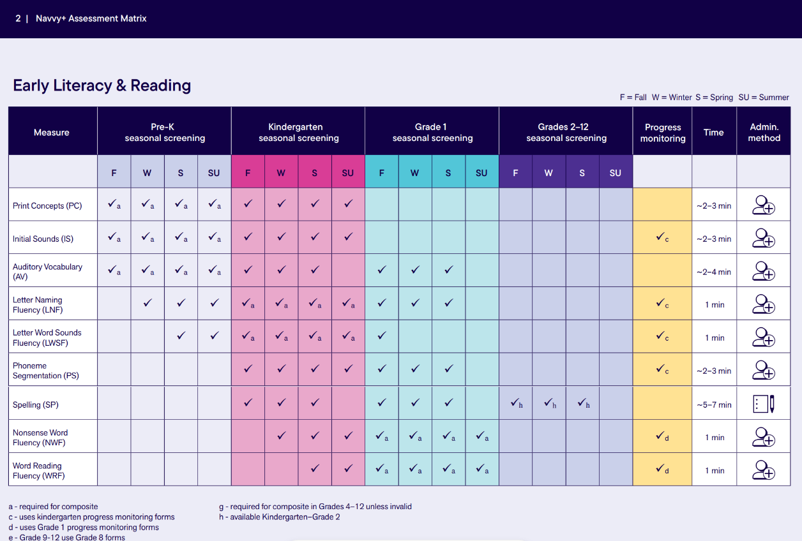
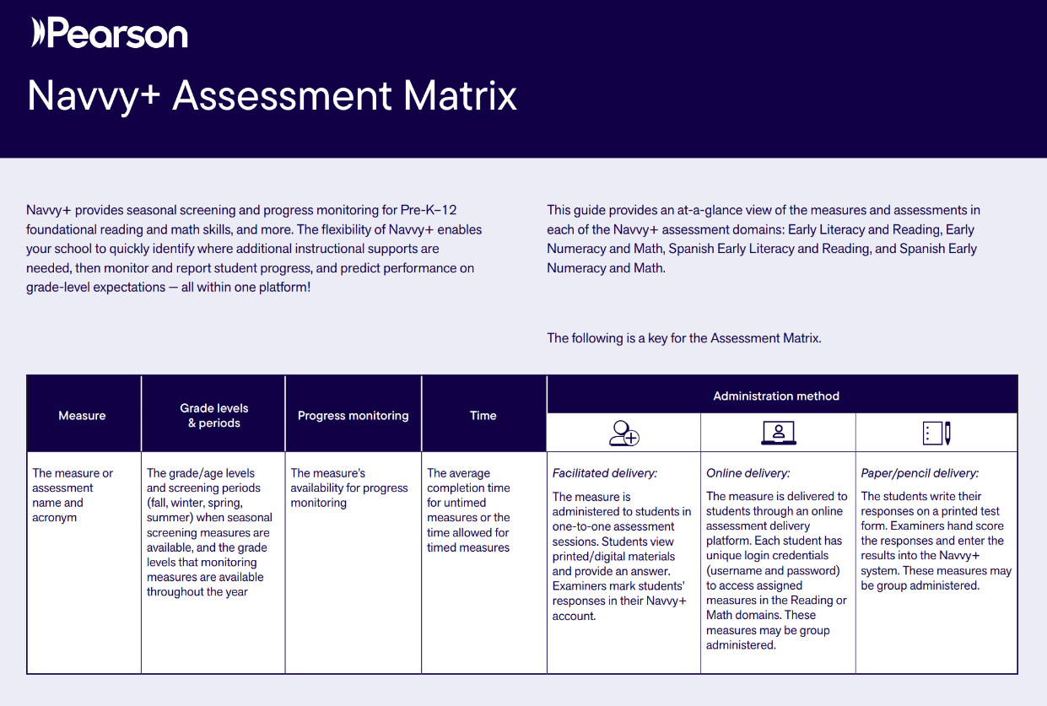
Screening & Progress Monitoring: Assessment Matrix
Seasonal screening overview

Slide 53

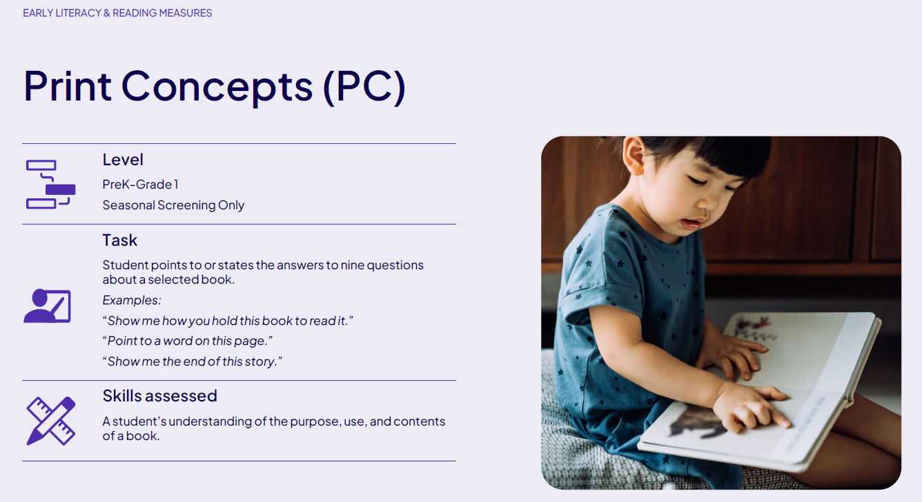
Screening & Progress Monitoring Measures
Seasonal screening overview
Guide with information on the level, example student tasks, and skills assessed for each measure

Slide 54

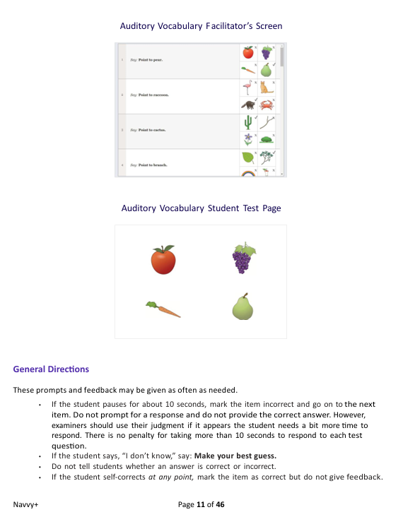

Administration & Scoring Guide
Seasonal screening overview
Find information on each measure along with directions and a script

Slide 55

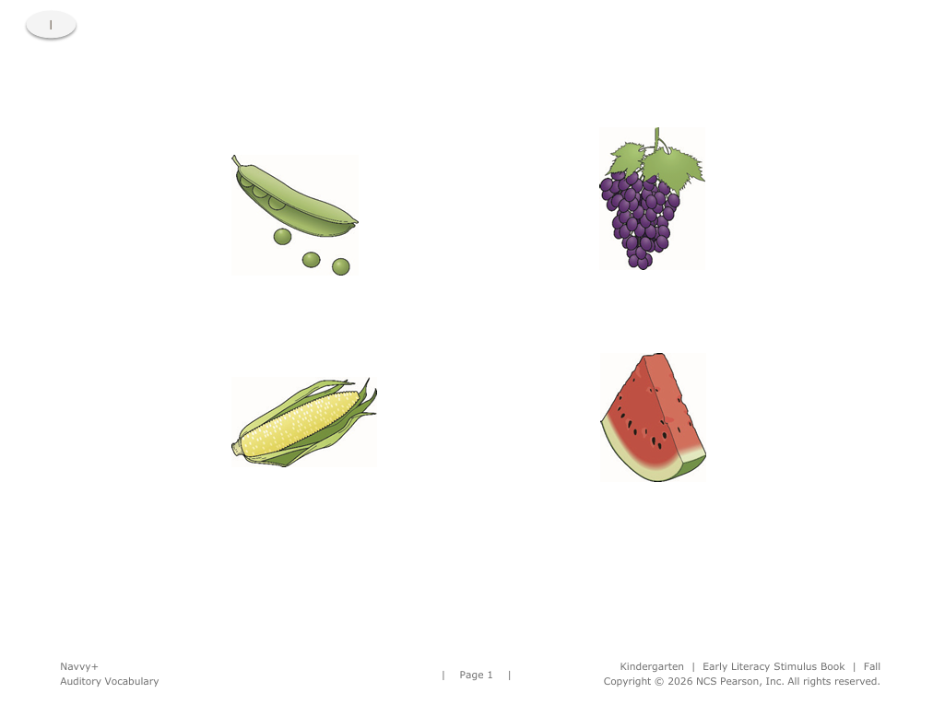
Stimulus books
Seasonal screening overview
Downloadable and printable books of the stimuli needed for measures
Consideration: Dedicate time for teachers to print and download materials needed

Slide 56
Seasonal screening overview
Platform
demo
Seasonal screening resources

Slide 57
Treasure hunt: Seasonal Screening
Seasonal screening overview
Review
Examine
Note
Open
Open and review the Navvy+ Screening & Progress Monitoring: Assessment Matrix
Look through the Navvy+ Seasonal Screening & Progress Monitoring Measures resource
Note which measures apply to your setting
Open the Administration and Scoring Guide and browse
5:00

Slide 58

Seasonal Screening
Using the measures

Slide 59
Seasonal screening: Using the measures
Facilitated Measure

Slide 60
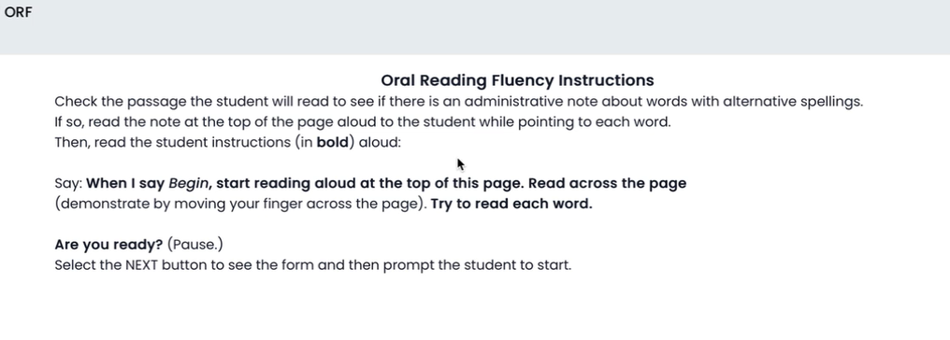
Facilitated delivery: Oral Reading Fluency (ORF)
Seasonal screening: Using the measures

Slide 61
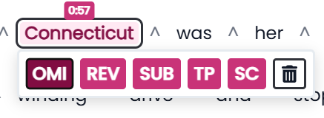
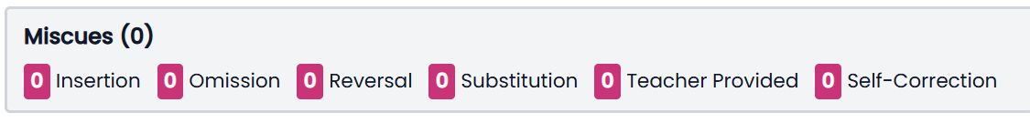
Scoring guidelines
Seasonal screening: Using the measures
If the student makes an error:
Click on the word and select the error type

Slide 62
Seasonal screening: Using the measures
Online Measure

Slide 63
Assigning an Online Measure
Seasonal screening: Using the measures

Slide 64
Online delivery: Vocabulary (VO)
Seasonal screening: Using the measures
Accessibility options
Text-to-speech

Slide 65
Scripts for online measures
Seasonal screening: Using the measures
“Today you’ll be taking a few [reading, math] tests on the computer. You’ll need to wear your headphones to hear the test directions. When there are words that can be read to you, you’ll see a play button on the right side of the screen. Just click on the play button if you want to hear the words.
There are a few parts to today’s [reading, math] tests. Make sure to keep working until each test is complete. Once you finish a test, you may go ahead to complete the next. Follow all the test directions, answer every question to the best of your ability at your own pace, and do your own work.
If you have any questions during the test, please stay seated and raise your hand- I will come over to you. Remember: Do your best! Put on your headphones now, and we’ll begin.”

Slide 66
Accessing Seasonal Screening
Seasonal screening: using the measures

Slide 67
Platform demo
Seasonal screening: Using the measures
Platform
demo
Facilitated & Online measure

Slide 68
Student experience
Seasonal screening: Using the measures
Login using Classlink and find the Pearson Launchpad app
Select subject
Separated by Seasonal Screeners and Checks

Slide 69
Student experience
Seasonal screening: Using the measures

Slide 70
Seasonal Screening
Results & Reports

Slide 71
Norm references and performance levels
Seasonal screening: Results & reports
1-10th percentile | Well Below Average
11-25th percentile | Below Average
26-74th percentile | Average
75-89th percentile | Above Average
90-99th percentile | Well Above Average
Math norms updated for 26-27 SY
English norms updated for 25-26 SY

Slide 72
Norms Tables
Seasonal screening: Results & reports
Choose filter

Slide 73
Roster by Screener
Seasonal screening: Results & reports

Slide 74
Student Individual Measure Results
Seasonal screening: Results & reports
Individual student report showing seasonal screening scores for a specific measure

Slide 75
Platform demo
Seasonal screening: Results & reports
Platform
demo
Results & reports

Slide 76
Considerations for Seasonal Screening implementation
Seasonal screening
All measures required for the Composite will be completed for each screening window. Will additional measures be completed?
Give schools dedicated time to print and download measures and supports needed to screen students.
Have a plan for how data will be used to inform instructional planning.

Slide 77
Best practices for implementation & what it looks like
Reflect & close
Best Practice | What it Looks Like
Start with the “why,” not the testing window | Help teams understand how assessment fits into your model and how results will be used to support students.
Identify a local implementation lead and build local expertise | Designate a local point person who knows the implementation expectations, resources, timelines, and escalation path.
Build screening windows into the school calendar early | Protect administration time and plan around holidays, events, common absences, and other assessments.
Protect dedicated time for data review | Put grade-level/PLC data meetings on the calendar early, even before screening begins.
Use a consistent data protocol that leads to explicit next steps | What do we notice? Who needs support? What skill needs exist? What will we do next?
Use multiple sources of evidence | Pair screener results with classroom performance, formative data, teacher observations, and other relevant evidence.
Approach Year 1 with an implementation learning mindset | After each window, ask what worked, what created friction, and what should change before the next one.

Slide 78
Revisit learning objectives
Reflect & close
Understand the functional purpose for Navvy+ in a school-wide data-based decision making model
Navigate the Navvy+ platform to identify resources and understand key workflows
Identify key planning considerations for effective implementation

Slide 79



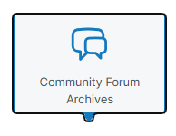
We’re here to help
Reflect & Close
DoWEA Portal
Community Support
Platform
https://dodea.mypearsonsupport.com/

Slide 80
Post PD survey
Post PD survey
Session: Leaders: Introduction and Use of the System
Learning Facilitator: Denise Ricks
https://tinyurl.com/ye234yun

